Slide 1
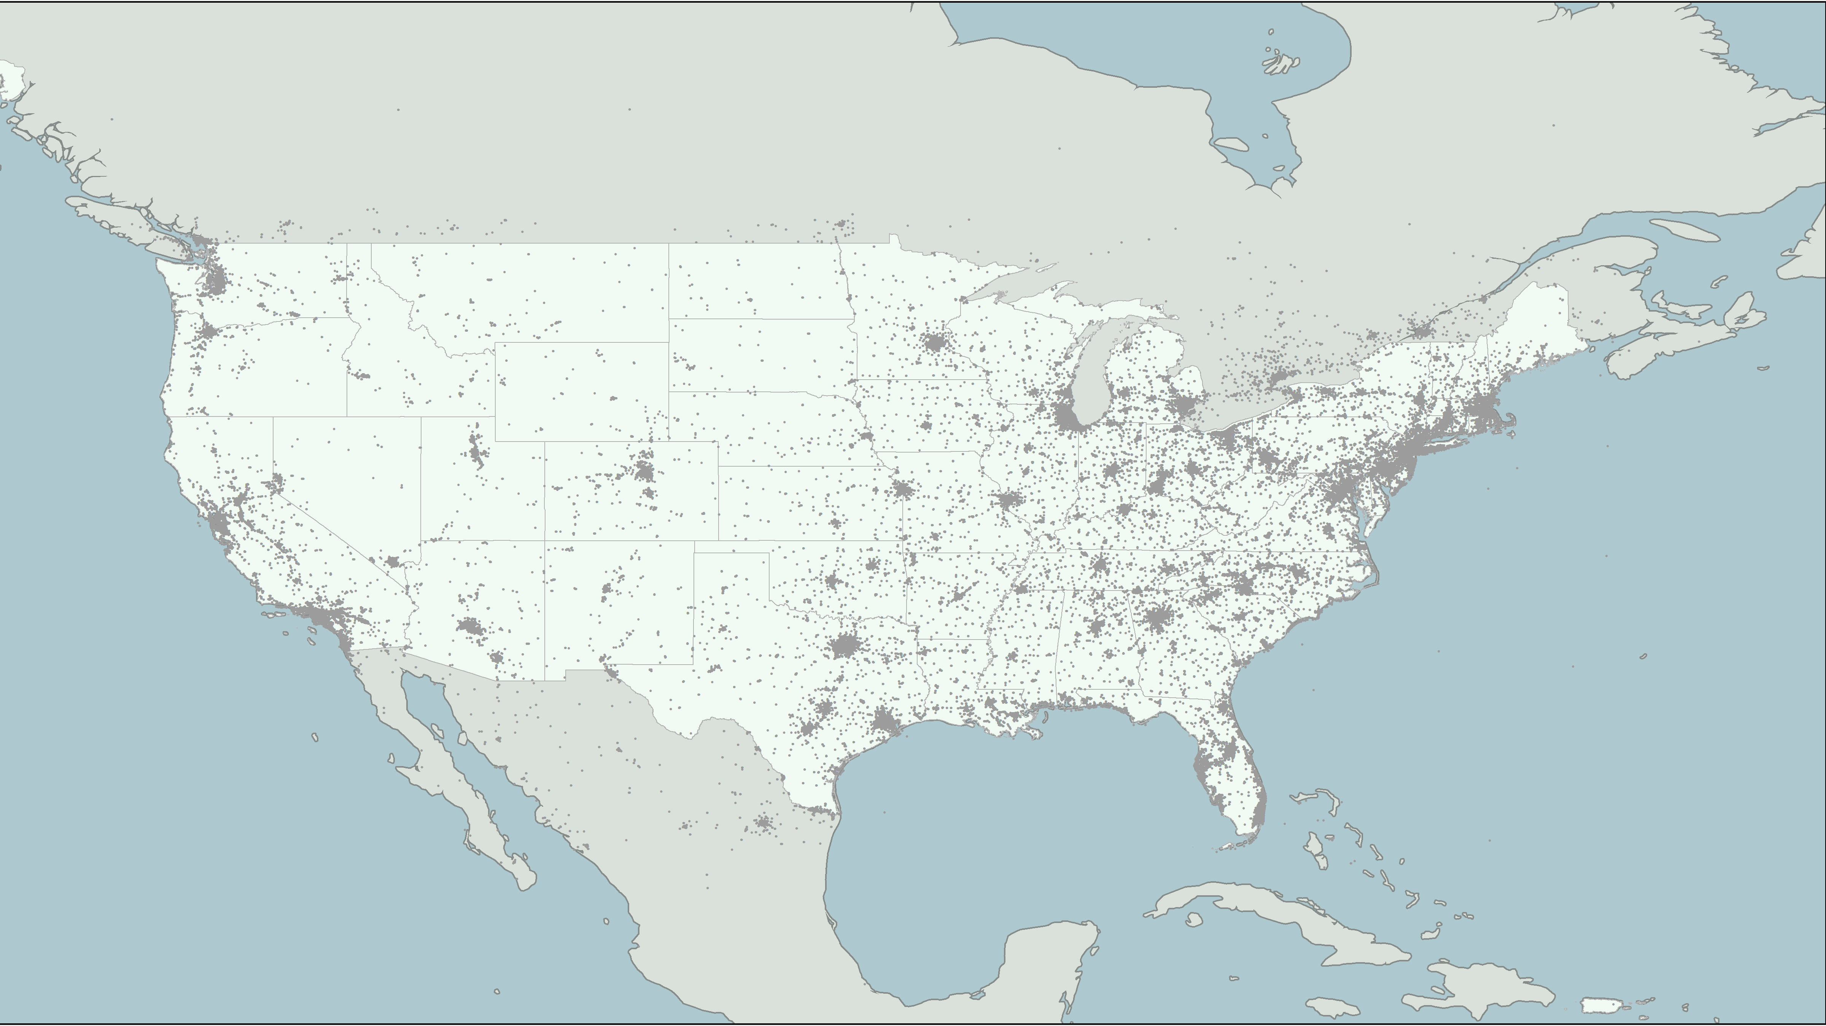
Does Religious Geography Predict
Sentiment Expression in Online Social Media?
Joey Marshall
Dept. of Sociology
Purdue University

Slide 2
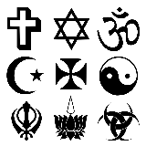

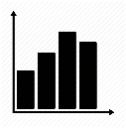


How do the religious characteristics of places influence the people who live there?
Religious context
Aggregate-level religious statistics
Online sentiment
Demographics
From Census and other data sources
Behavior
Place data
What people do
Attributes
Inlcuding crime rates, regional location, etc.
Semi-stable human characteristics

Slide 3
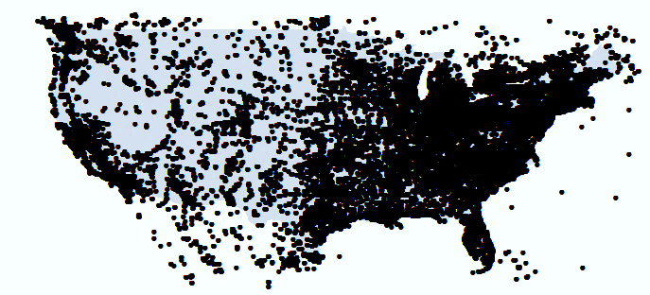
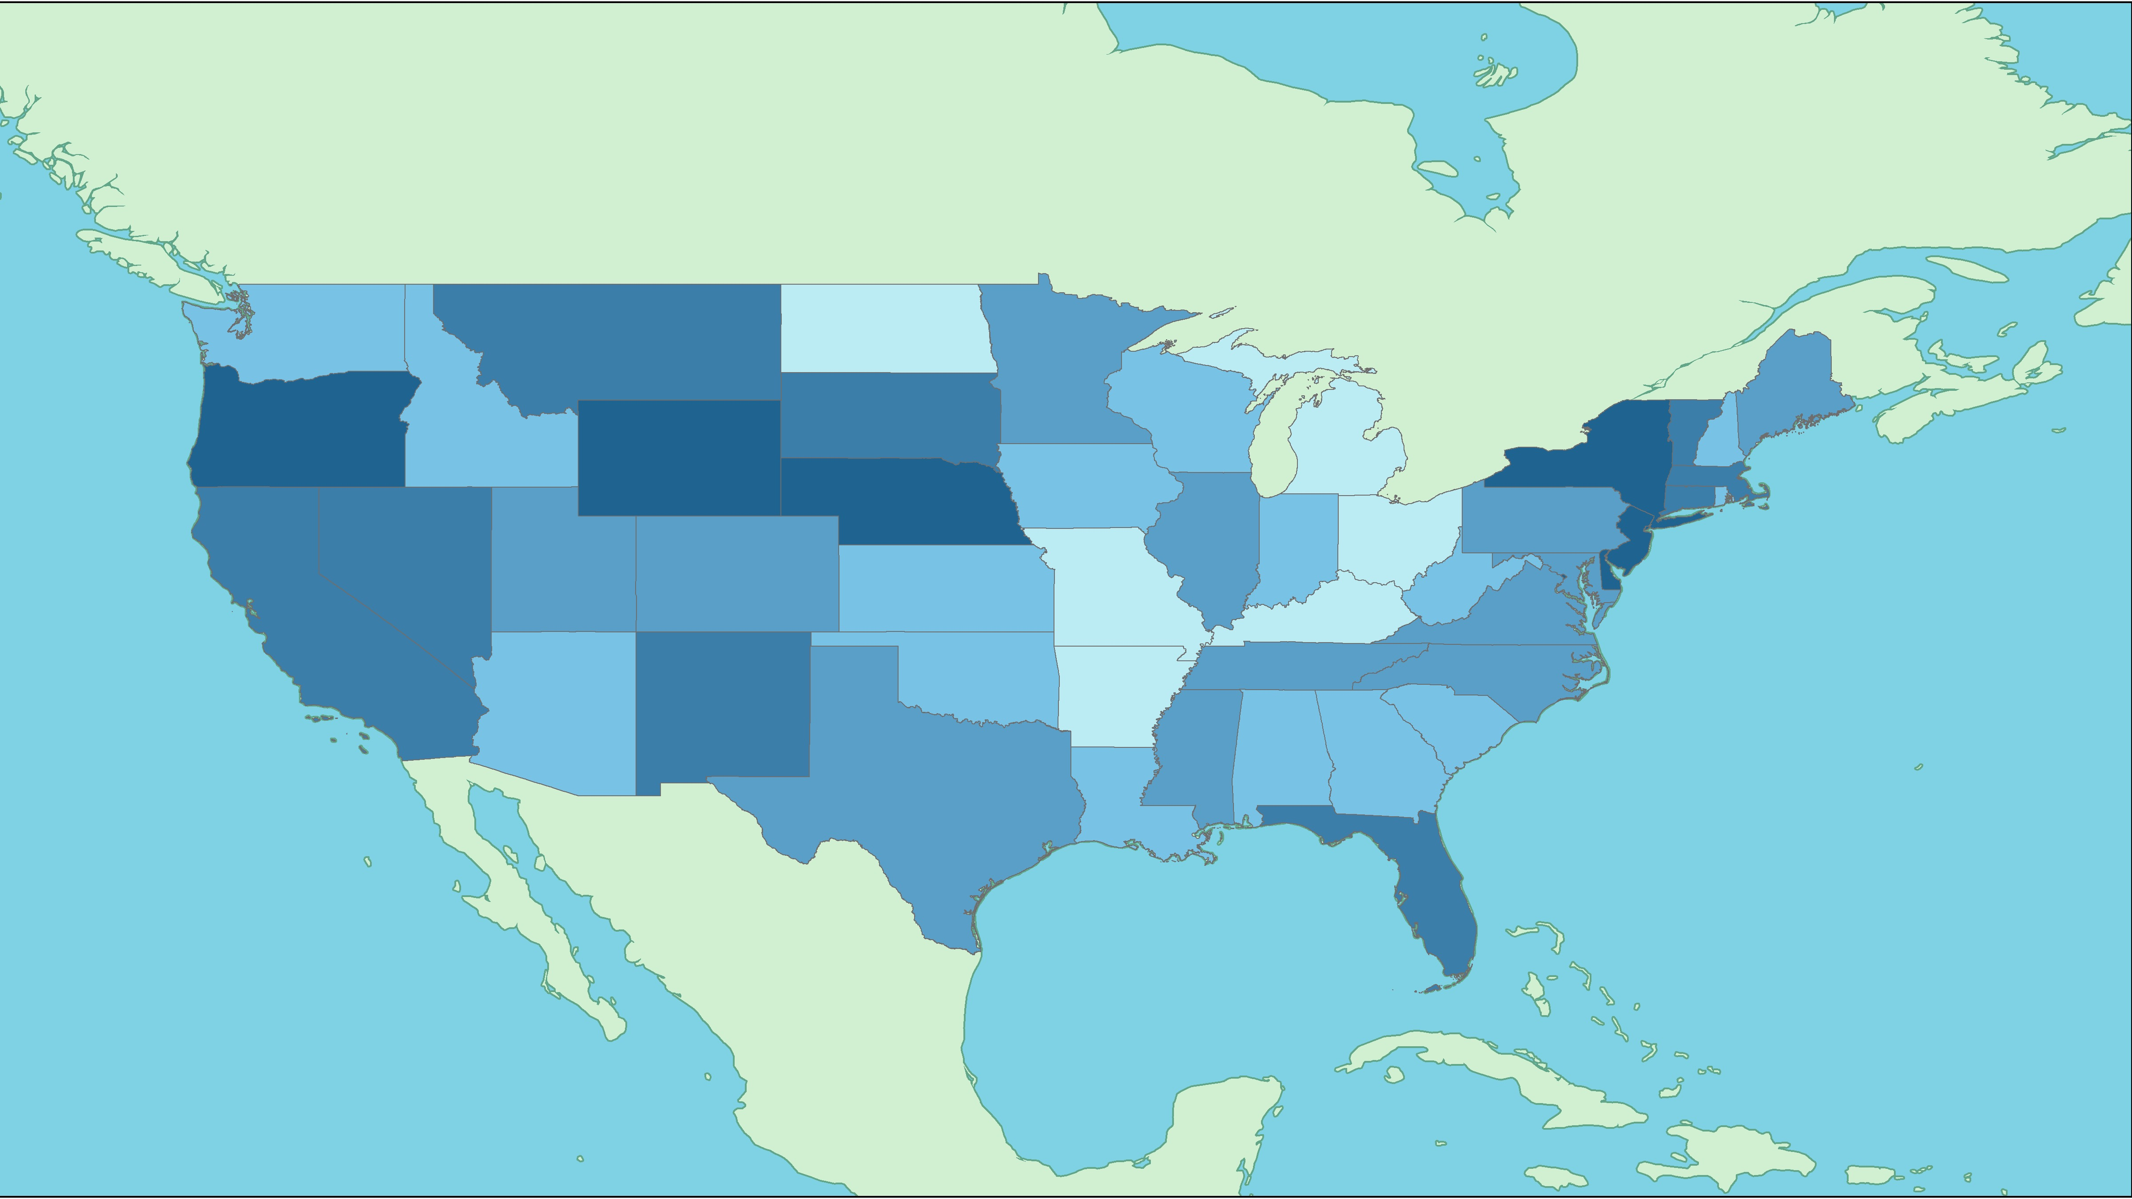
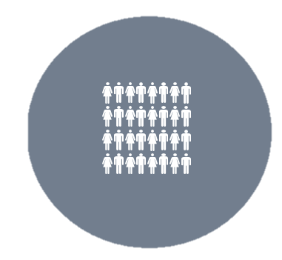
Religious context and online sentiment expression
Tweets. n=532,388
Tweets
Text, tweet attributes (retweets, favorites), location
States. n=52
RCMS
% Evangelical
% Mainline
% Catholic
% Black Protestant
Census and other
Basic demographics
Earnings
Crime
Inc. inequality

Slide 4
Religious context and online sentiment expression
Tweets. n=532,388
Polarity
Tweets
Text, tweet attributes (retweets, favorites), location
Positive
Negative
Tweet classification
Naïve Bayes classifier, trained on 10K hand-labeled tweets
Unigram tokenization
Preprocessing:
Lowercase, stopwords, punctuation, @#, numbers, html
Algorithm performance
Precision: 0.74
Recall: 0.72
f.measure: 0.73
Accuracy: 0.68

Slide 5
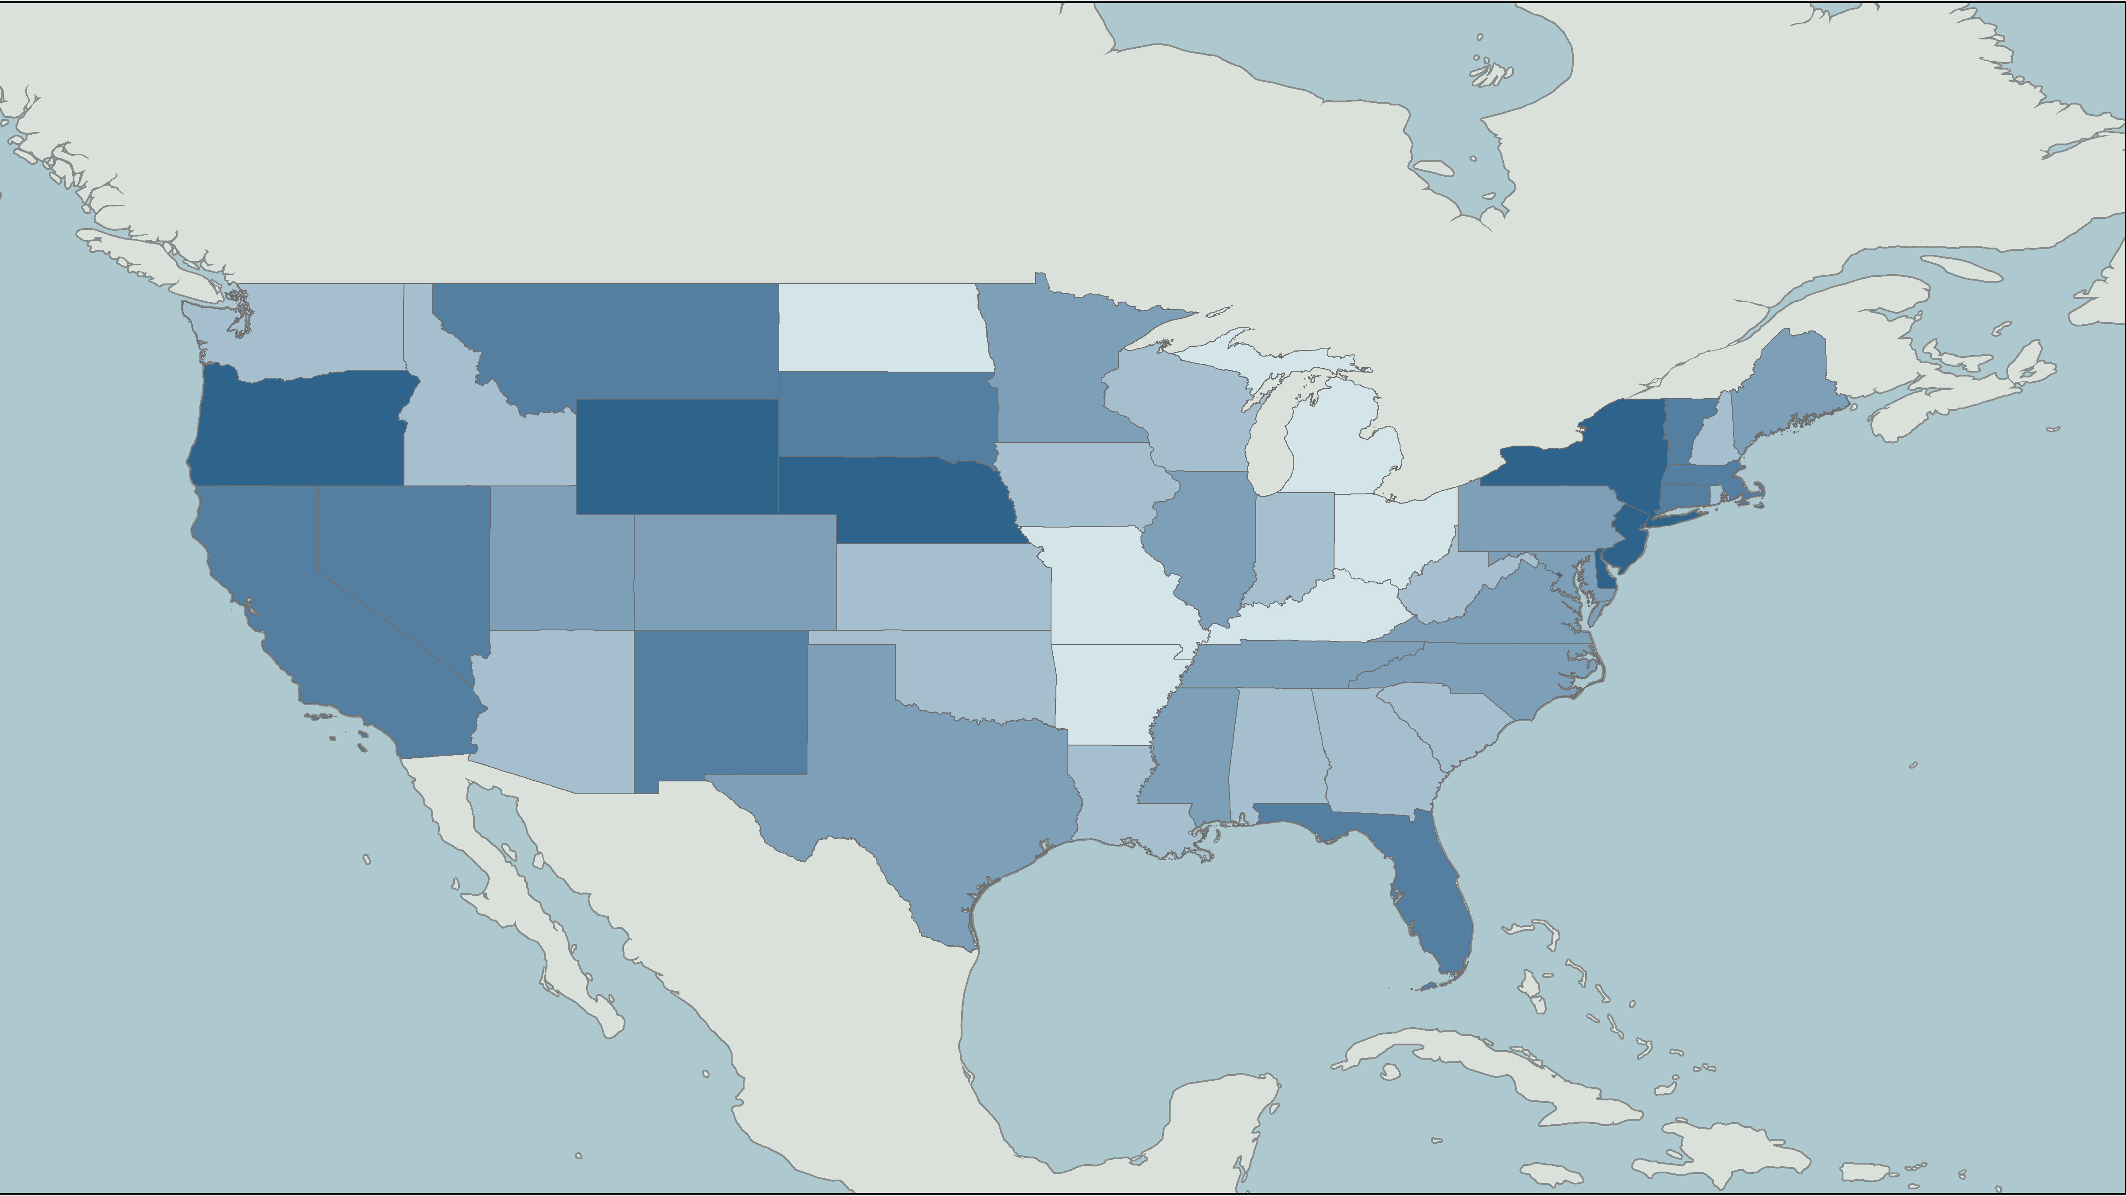
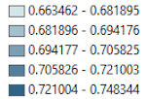
State-level sentiment
map of the United States

Slide 6
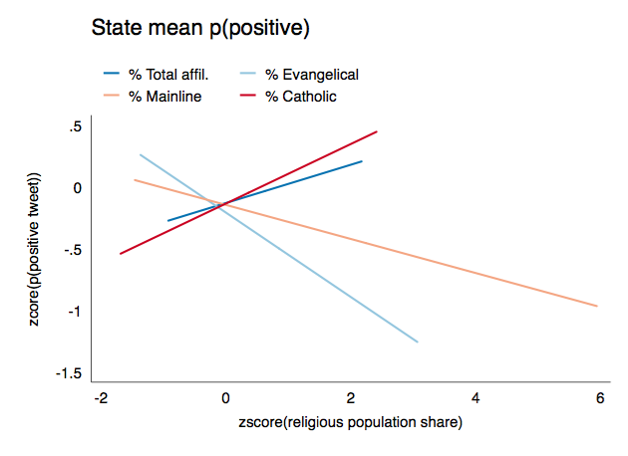

Slide 7
OLS regressions predicting positive tweet classification
 | b | (se) | β | b | (se) | β
State % evangelical | -0.06* | (0.02) | -0.34 | -0.05 (p=.10) | (0.03) | -0.27
Crime rate |  |  |  | 0.06 | (0.23) | 0.05
Prop. male |  |  |  | 0.22 | (0.40) | 0.10
Median income |  |  |  | 0.00 | (0.00) | 0.27
Gini index |  |  |  | 0.13 | (0.17) | 0.16
Population |  |  |  | 0.00 | (0.00) | 0.04
Intercept | 0.71*** | (0.00) |  | 0.51* | (0.25)
States | 49 |  |  | 49
R² | 0.12 |  |  | 0.17
Standard errors in parentheses * p < 0.05, ** p < 0.01, *** p < 0.001

Slide 8
Religious context and online sentiment expression
Tweets. n=532,388
Dictionary of words associated
with anger, sadness, fear, trust,
joy, anticipation, surprise
Tweets
Text, tweet attributes (retweets, favorites), location
lol ASR is pretty cool in general but this presentation is boring
Proportion joy words: 3/12 = .25
Proportion sadness words: 1/12 = 0.083

Slide 9
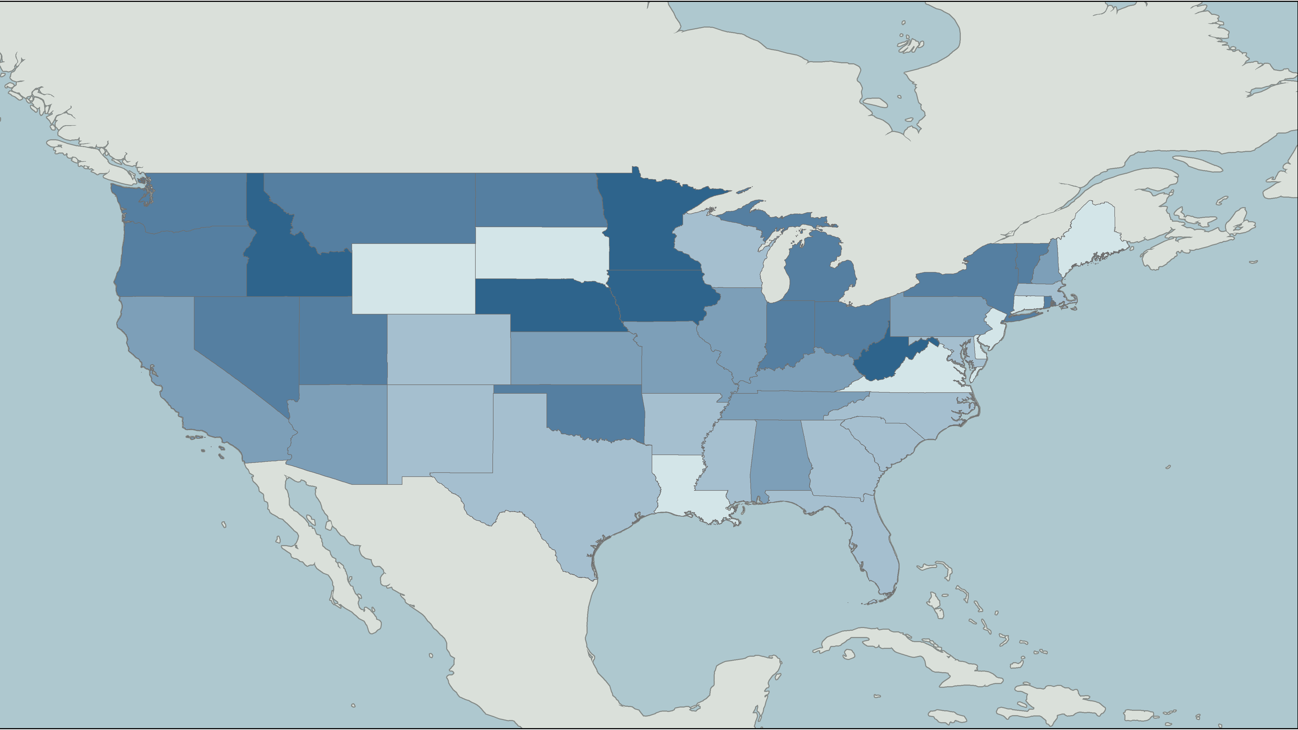
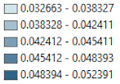
Mean proportion of “joy”
words per tweet, by state

Slide 10
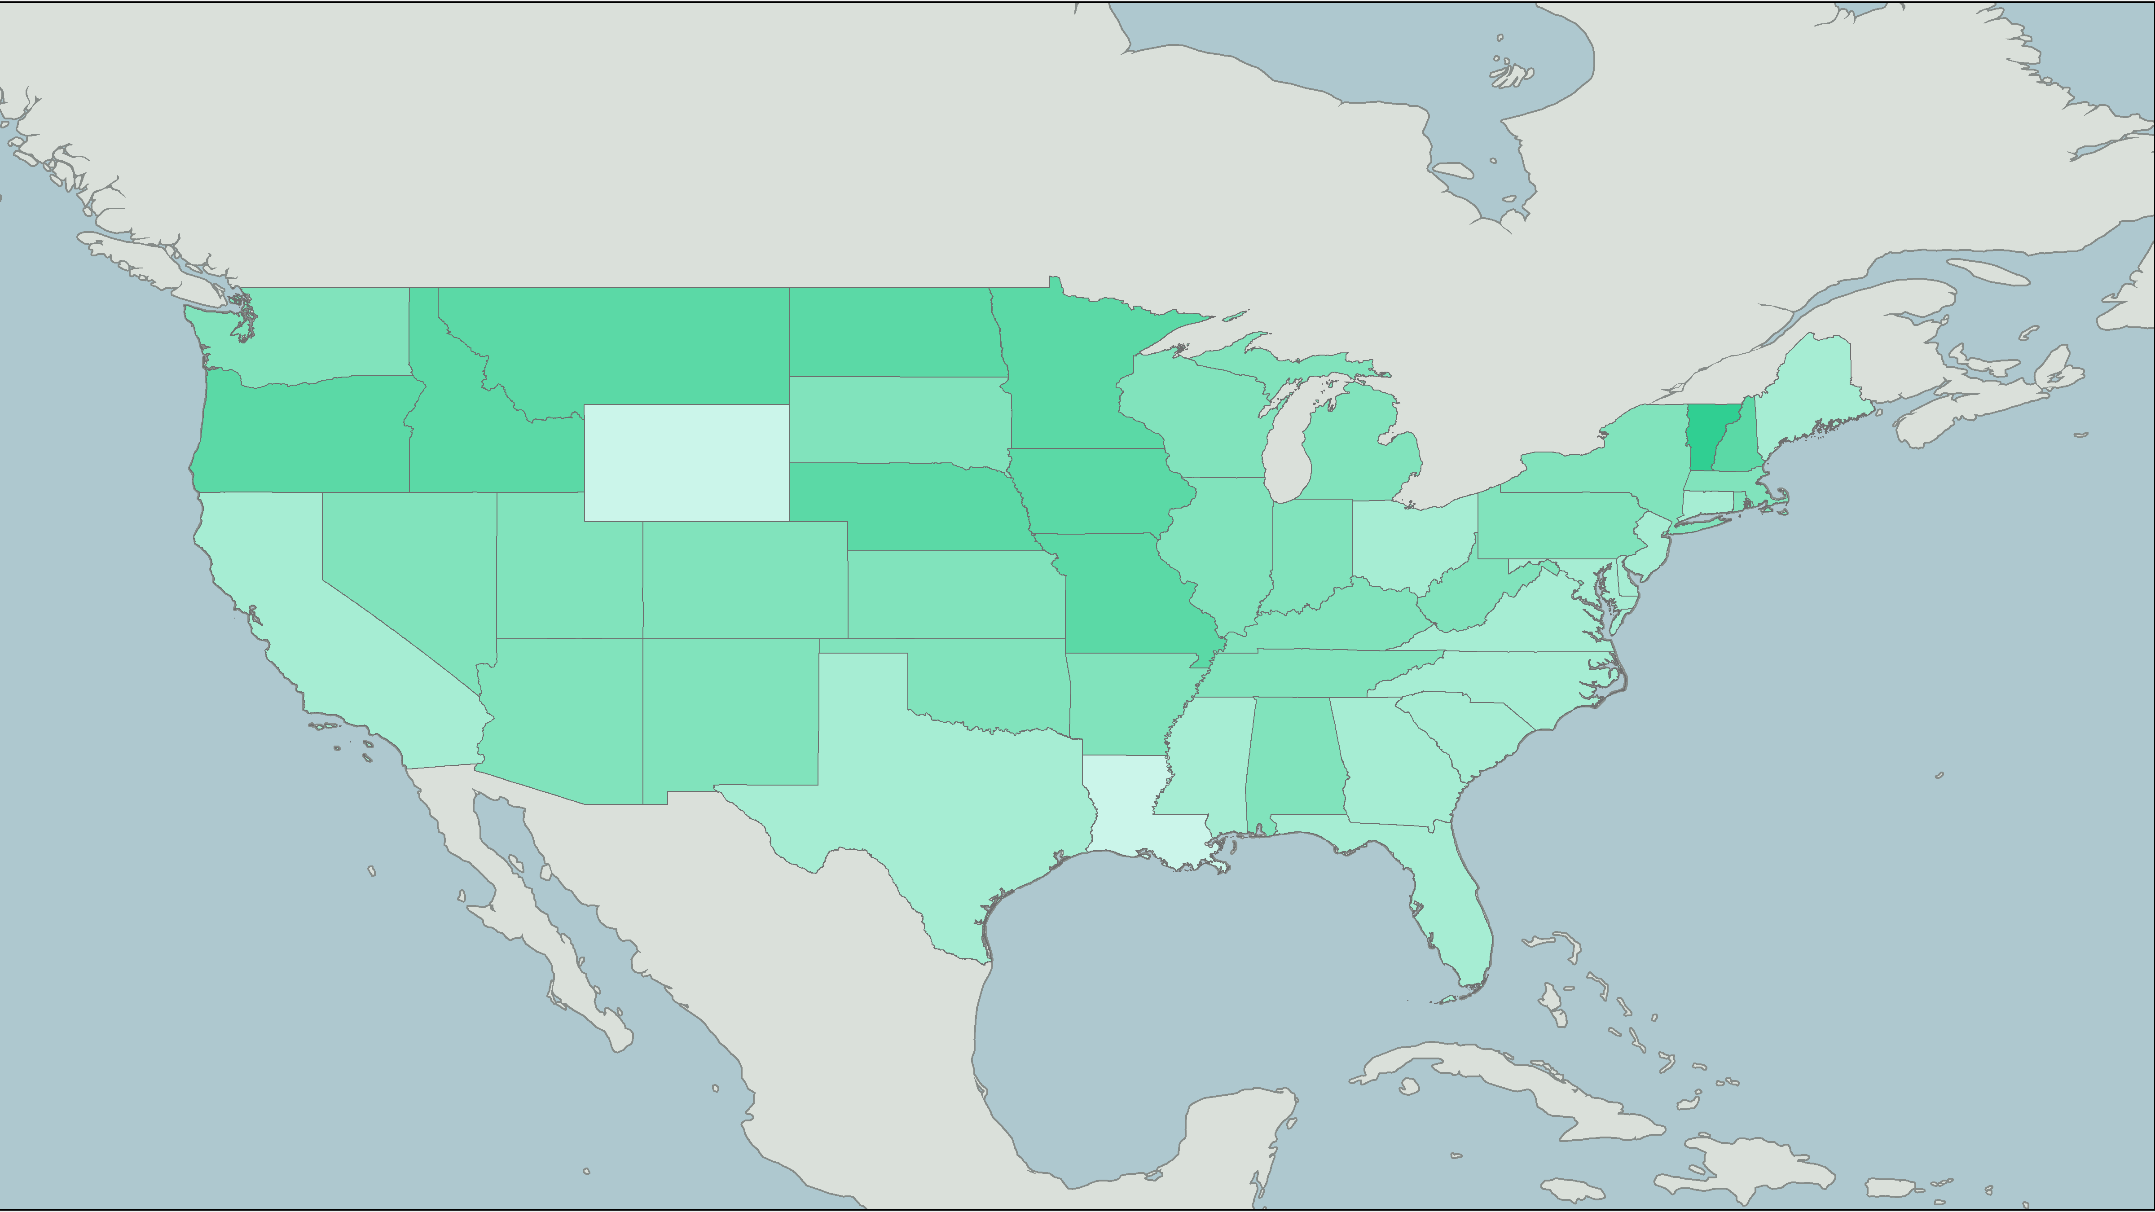
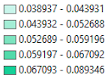
Mean proportion of “trust”
words per tweet, by state

Slide 11
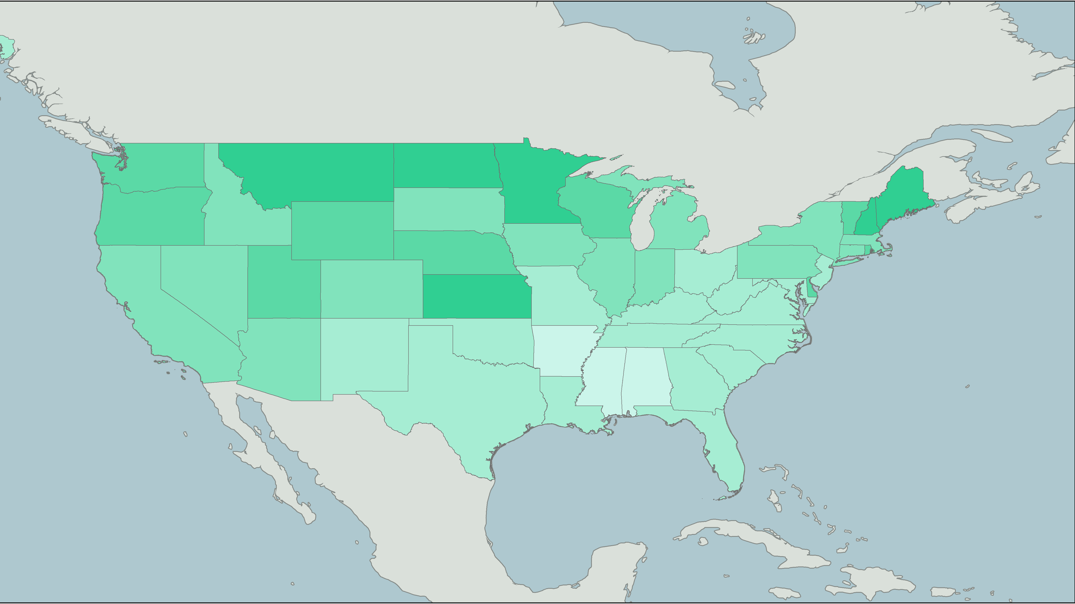
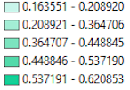
State-level mean on the
GSS “trust” item (1-3)

Slide 12
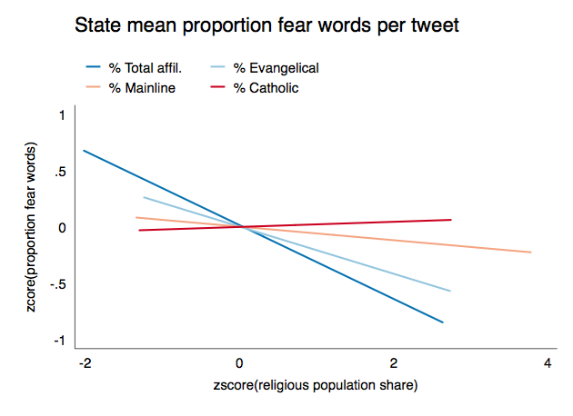

Slide 13
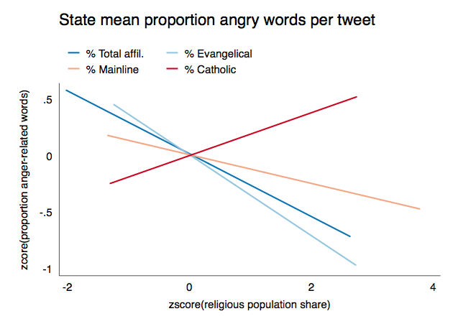

Slide 14
Conclusions:
Some evidence that evangelical Protestant concentration negatively predicts tweet sentiment
Total religious population seems to negatively predict fear and anger
More importantly: what else can we do with this method?
Twitter as data
Pros: “trace” data / unobtrusive measures; scale; demonstrated connection to real-world outcomes
Cons: unrepresentative; machine learning isn’t magic
Does religious context matter?

Slide 15

How do the religious characteristics of places influence the people who live there?
Religious context
Generalized social trust
Aggregate-level religious statistics
Demographics
Online sentiment
From Census and other data sources
Behavior
Place data
What people do
Attributes
Inlcuding crime rates, regional location, etc.
Semi-stable human characteristics

Slide 16
Does Religious Geography Predict
Sentiment Expression in Online Social Media?
Joey Marshall
Dept. of Sociology
Purdue University

Slide 17
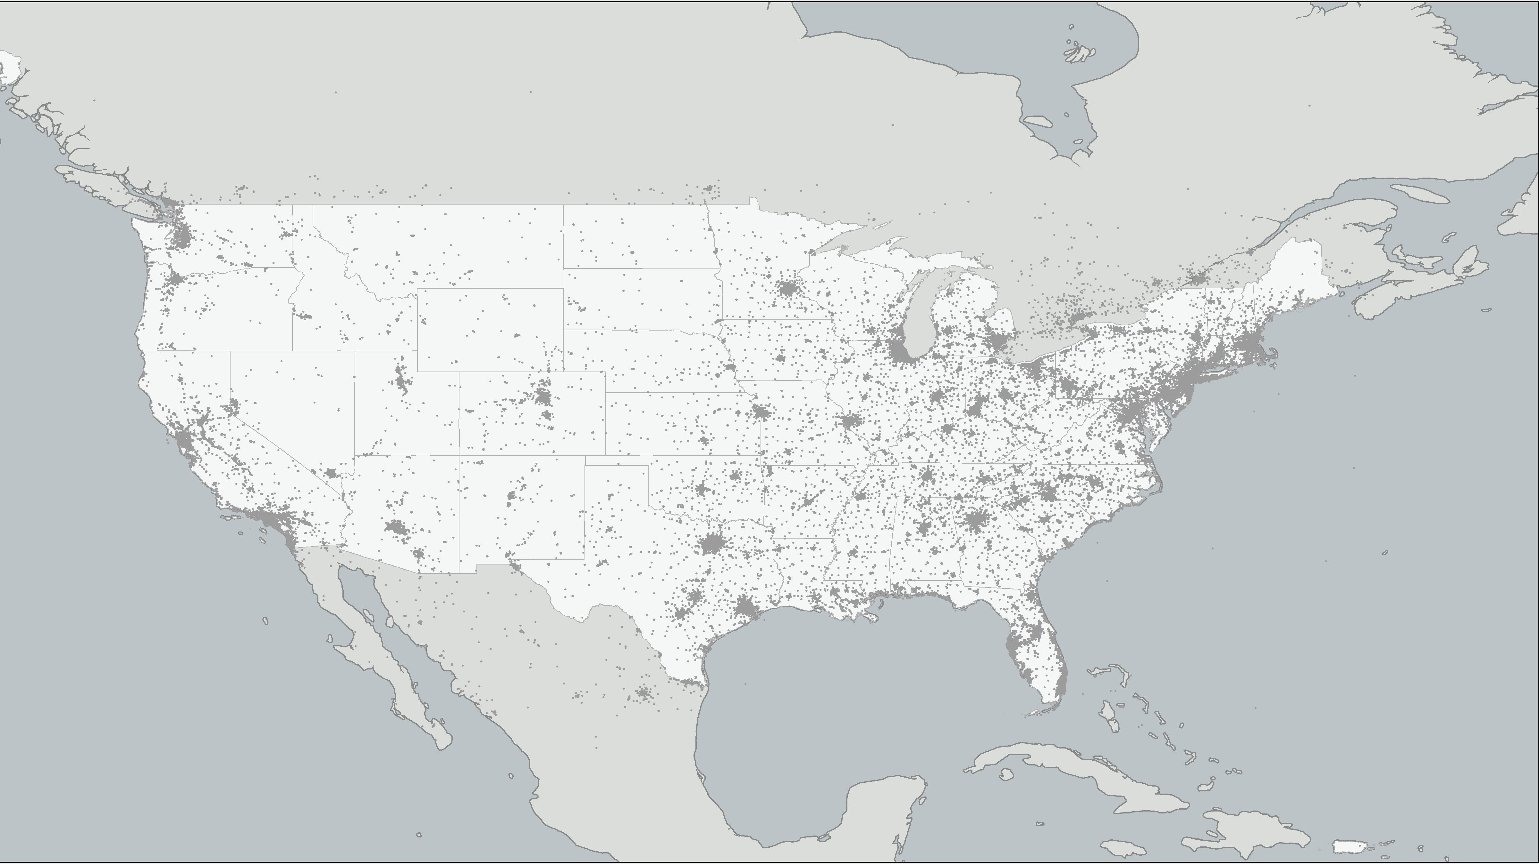
Does Religious Geography Predict
Sentiment Expression in Online Social Media?
Joey Marshall
Dept. of Sociology
Purdue University

